Slide 1


Social Buzz
DATA ANALYSIS AND DATA VISUALISATION

Slide 2


Today's agenda
Project recap
Problem
The Analytics team
Process
Insights
Summary

Slide 3

Social Buzz is a content-centric social media platform that emphasizes user anonymity and diverse reactions to content, prioritizing trending topics over individual profiles. With rapid growth to over 500 million monthly active users, Social Buzz is now seeking advisory support to manage its scaling process effectively in preparation for a potential IPO.
Accenture is focusing on :
An audit of their big data practice
Recommendations for a successful IPO
- An analysis of their content categories that highlights the top 5 categories with the largest aggregate popularity
Project Recap

Slide 4

Problem
Every day over 100,000 pieces of content, ranging from text, images, videos and GIFs are posted. All of this data is highly unstructured and requires extremely sophisticated and expensive technology to manage and maintain.
So to Capitalize on it :
Analysis to find Social Buzz’s top 5 popular categories of content.

Slide 5



MADULIKA PRABUSANKAR
Data Analyst
The Analytics team
MARCUS ROMPTON
Senior Principle
ANDREW FLEMING
Chief Technical Architect

Slide 6
Process
1
Data Collection and Data Understanding
2
Data Cleaning
3
Data Modelling
4
Data Analysis
5
Uncover Insights

Slide 7
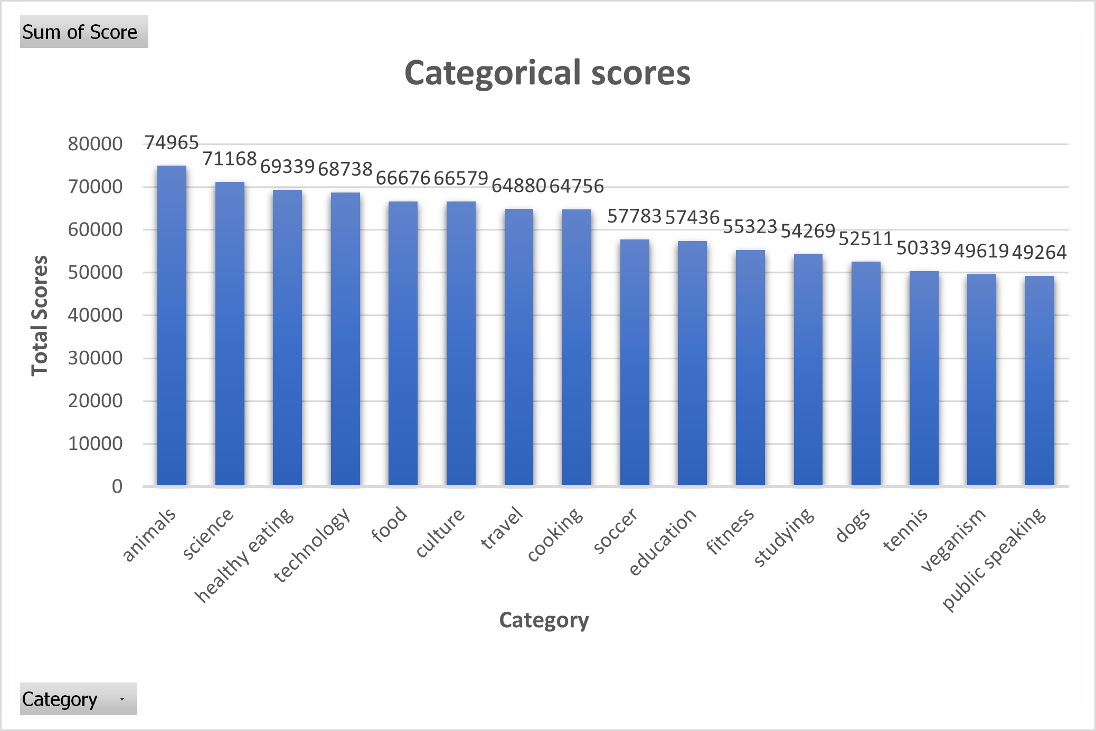
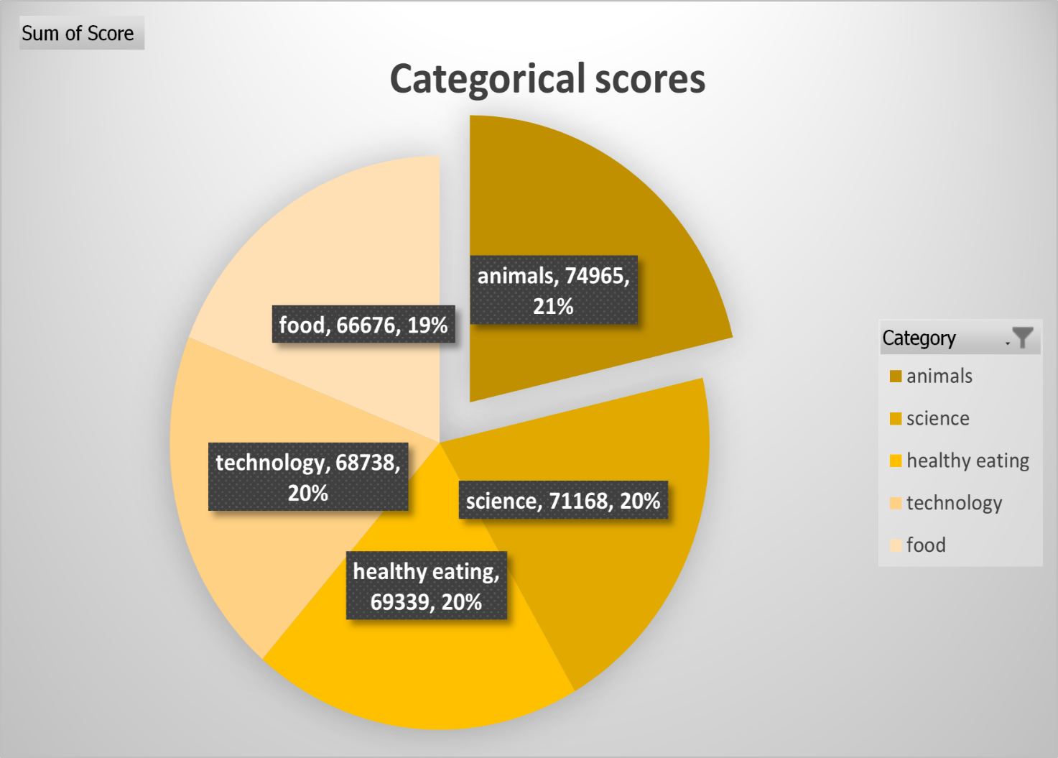

Insights

Slide 8
Based on content performance, topics related to animals generate more engagement than those related to science. This suggests the audience finds animal content more interesting and adorable than others. More Positive sentiment is found in Animals, Science, healthy eating, Technology, food.
This chart depicts the aggregate score for the five highest-performing categories across two distinct years (2020 and 2021).Content engagement experienced year-over-year growth, although the top five categories showed a slight moderation in 2021 compared to the exceptional performance in 2020.

Slide 9
This chart, depicting the total content creations by type, reveals a dominance of photo content over video content. The photo content creation taking up a larger portion of the pie chart at 6589 and video creation coming in at a lesser 6245. Least of all is found to be audio content creation. To enhance brand usage, we can focus on optimizing video content creation elements to increase its appeal and user engagement.

Slide 10
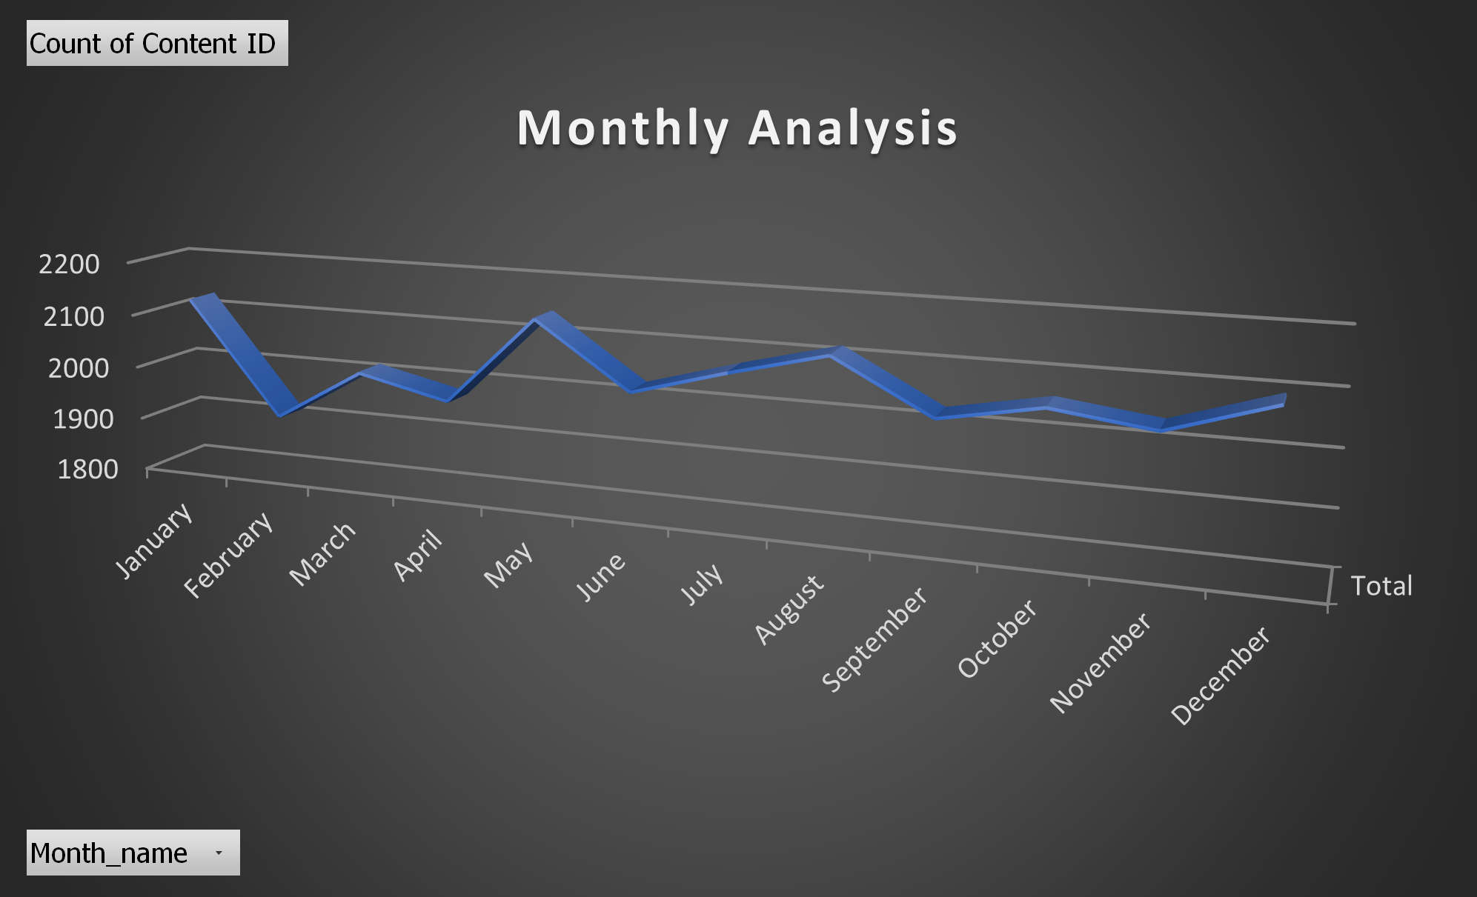
This graph reveals a year-long increase in content creation, with January and May boasting the highest output. This suggests a strategic focus on content generation. However, the fluctuations throughout the year might indicate seasonal trends or specific marketing initiatives. By analyzing these trends and the content types being created, So now it is easier to optimize the strategy for better results. This monthly breakdown of top content categories reveals a clear dominance of "Healthy Eating" throughout the year. By investigating these trends and potential content gaps, you can tailor your content strategy to better resonate with user preferences and maximize user engagement.

Slide 11
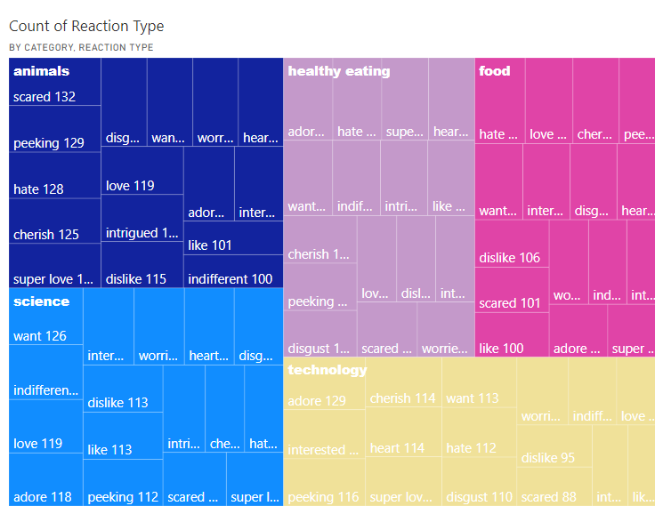
Analysis of user reactions revealed that
"Animals" had higher 'Scared' reactions,
"Healthy Eating" and "Technology" received 'Adore’,
"Science" saw 'Want', and
"Food" had 'Hate’.
Tailor content to balance animal content, leverage positive sentiment in health and tech, offer interactive science content, and improve food presentations.

Slide 12

• The higher the score, the more popular the category. In Total of 16 categories, the top 5 categories are : Animals, Science, Healthy eating, Technology, Food.
• Healthy Eating Reigns Supreme: Healthy eating content consistently tops the charts, indicating strong user preference.
• Engagement on the Rise: User engagement seems to be increasing overall, despite some fluctuations throughout the year.
• Seasonal Swings: Scores fluctuate monthly, potentially influenced by seasonal trends. (e.g., healthy eating might spike in January for resolutions)
• Content Gaps Possible: The big gap between Healthy Eating and other categories suggests there might be room for improvement in those areas.
• Top 5 Revealed: Based on performance, the top 5 categories are Healthy Eating, Animals, Science, Technology, and Food.
Summary
Link for a Detailed Power BI Dashboard : final_analysis.pbix

Slide 13
Thank you!
ANY QUESTIONS?

